Slide 1

Lecture 1: Introduction
IBIO, Molecular Phylogenetics 2024
Jadranka Rota and Niklas Wahlberg
Systematic Biology Group
Department of Biology
Lund University

Slide 2
Aims
Cover key concepts in phylogenetics
E.g. monophyly, homology, analogy
Explain why evolutionary history is important in biology
Understand the basics of statistical phylogenetic inference
Develop “tree thinking”

Slide 3
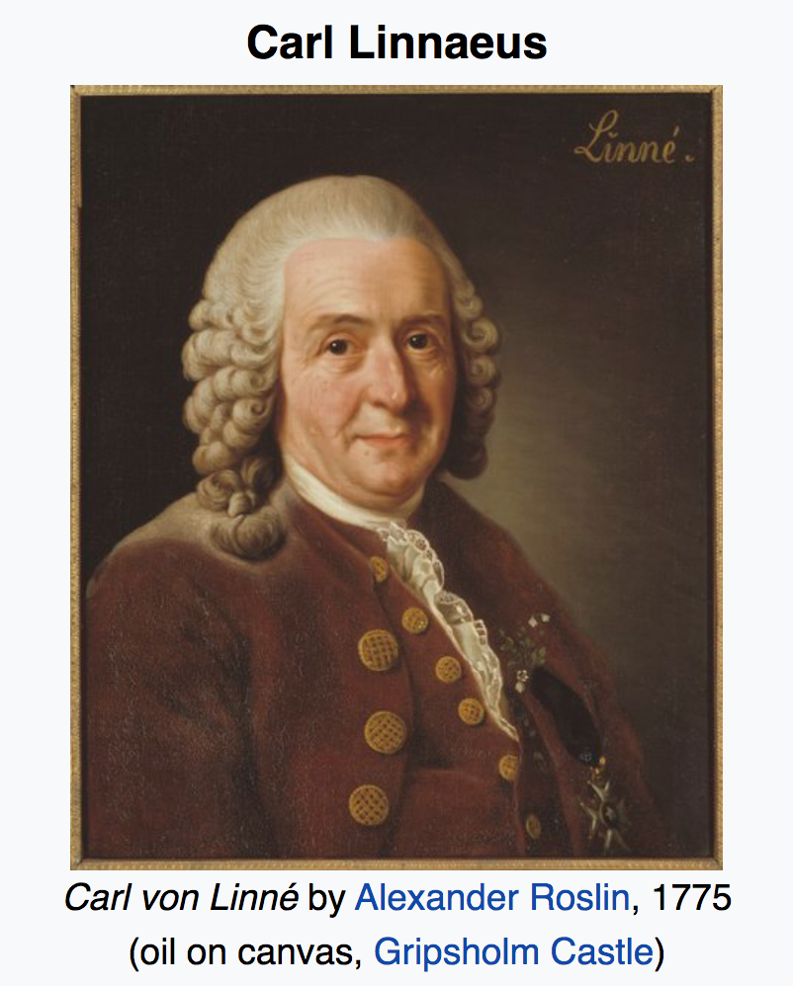
Systematics is ….
The scientific study of the kinds and diversity of organisms and of the relationships among them
Traditionally: taxonomy (naming and classifying organisms, Greek "taxis" = arrangement, and "nomos" = law)
Since ca. 1980s: largely based on phylogenetics (first morphological, then molecular)
Most recently: including phylogenomics
Provides essential framework for recognition and study of biodiversity and evolution
Known as the “Father of modern taxonomy”
(Source: Wikipedia)

Slide 4
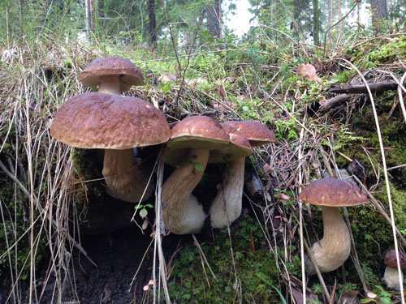
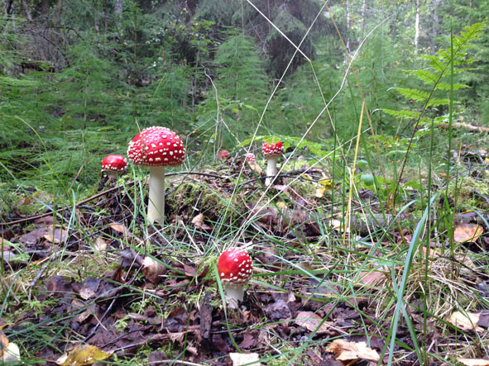
Human need for taxonomy
Naming of organisms around us
Makes communication a lot easier!
Sorting different groups into higher categories
Helps us organize the living world around us
E.g. porcini (Karljohanssvamp) is an edible species of mushrooms, but many other mushrooms are very poisonous, e.g. fly amanita (Röd flugsvamp)
Porcini - Boletus edulis Bull. (1782)
Note: one taxon, many taxa (in some Greek words singular ending is –on, plural is –a, e.g. also phenomenon, phenomena)
Fly amanita - Amanita muscaria (L.) Lam. (1783)

Slide 5

Systematics also includes…
The study of character evolution
The study of molecular evolution
The study of speciation/extinction dynamics
The study of historical biogeography
The study of the temporal framework of evolution

Slide 6
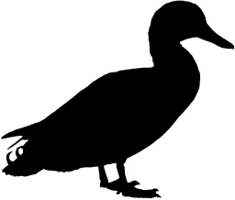
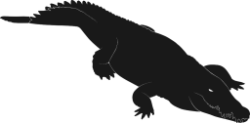
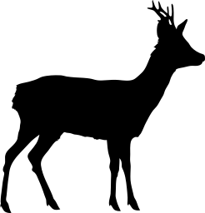
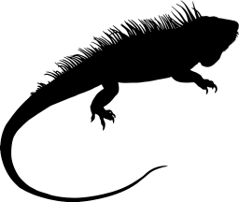


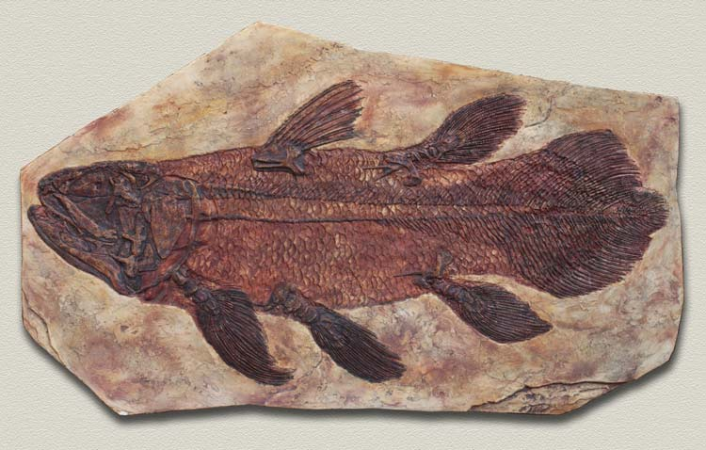
Evolutionary History
How do we learn about the evolutionary history of organisms?
Why should we care about it?

Slide 7
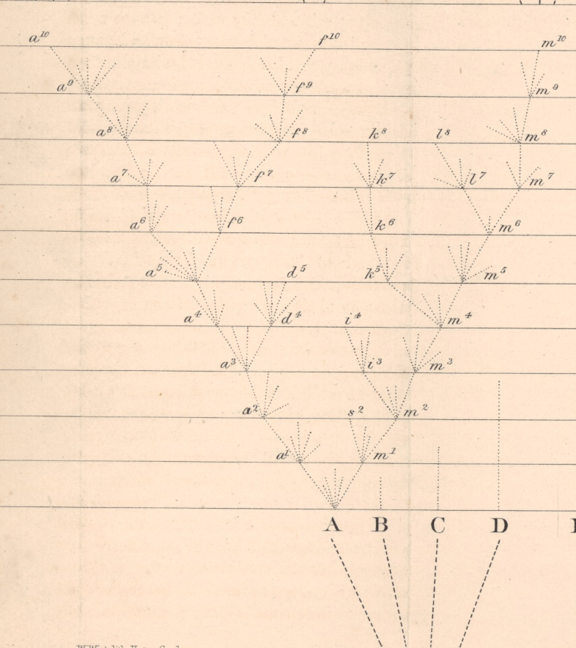
“Nothing in biology makes sense except in the light of evolution”
- Theodosius Dobzhansky, essay written in 1973
“Nothing in evolution makes sense except in the light of phylogeny”
- Quote from Jay Savage, in 1997 Society of Systematic Biology Presidential Address
The only figure in Darwin’s On the Origin of Species

Slide 8
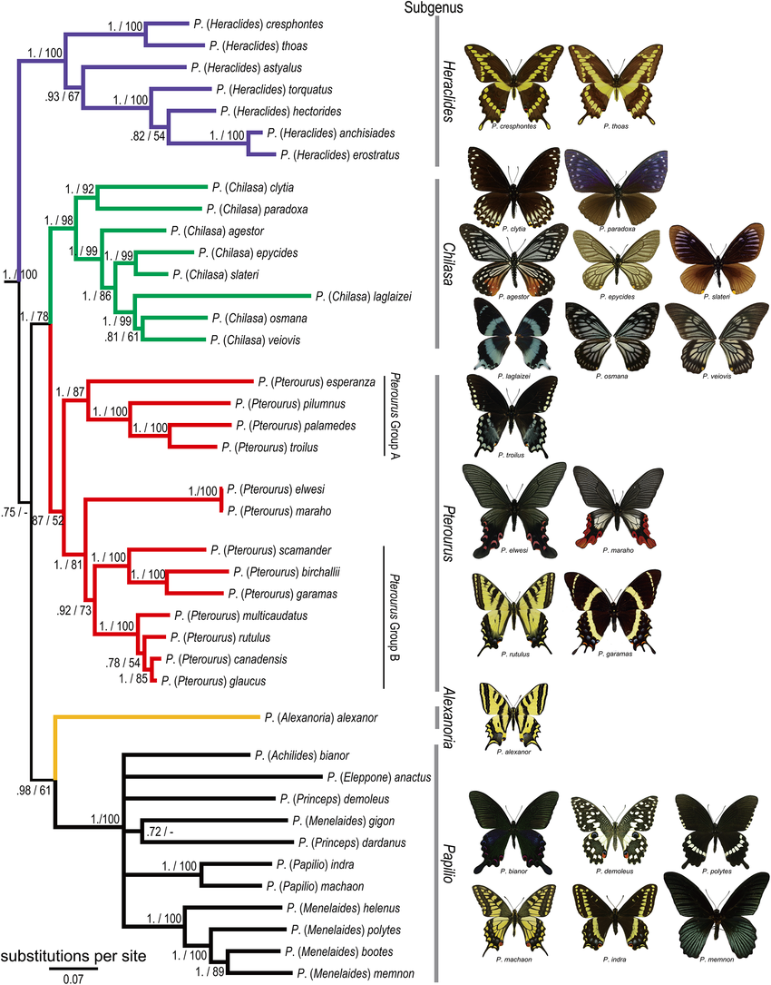
The very basic facts
What we see today in nature is the outcome of what has happened in the past
Ecology and evolution are inseparable
“Species” or “genes” are not individual entities without any connections to other species or genes
phylogeny

Slide 9
What is a phylogeny?
A phylogeny is the historical genealogy of a group of species

Slide 10
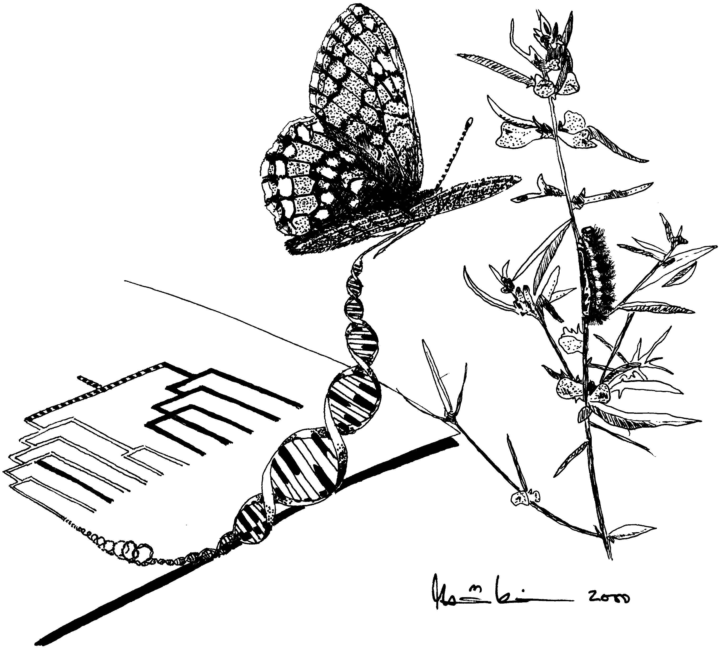
A phylogeny is an inference
Envisioned as a dichotomously branching tree
A phylogeny cannot be observed
A phylogenetic hypothesis can be inferred from observed data

Slide 11
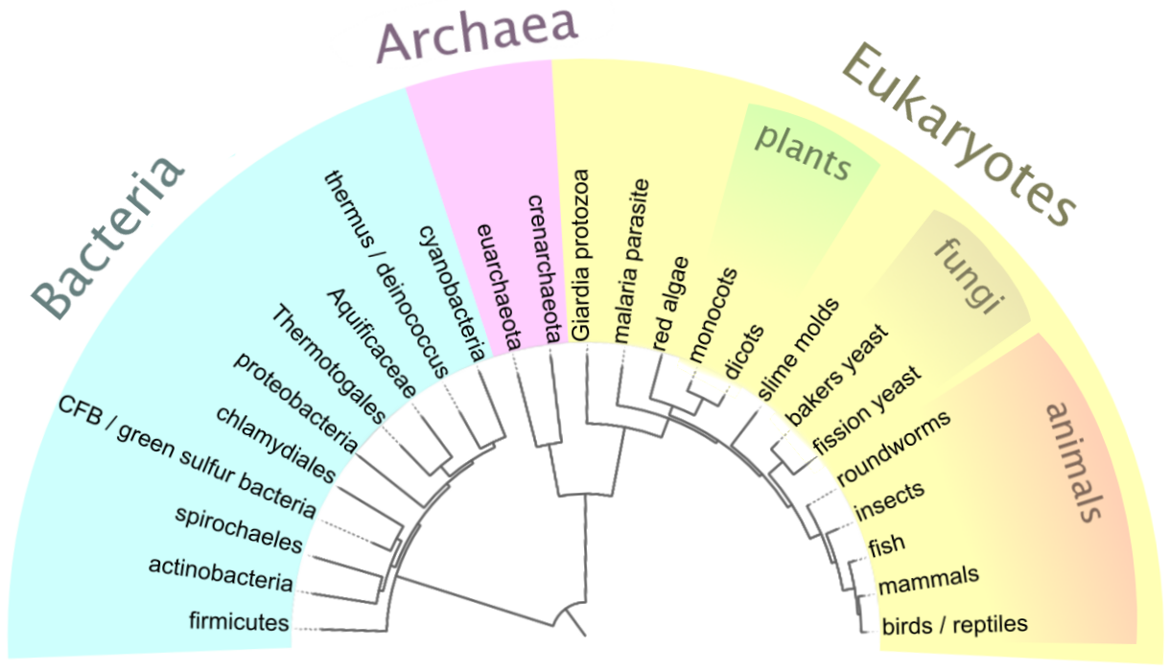
What we are after
Phylogenies – the Tree of Life
With phylogenies we are attempting to get a good working framework for Life
Getting to the root of how evolution has worked
Source: Wikipedia

Slide 12
Some basic concepts
Cladogram – a tree diagram which depicts a hypothesised evolutionary history (topology)
Phylogram – a tree which indicates by branch length the degree of change believed to have occurred along each lineage (topology with informative branch lengths)
Chronogram – a tree in which branch lengths are directly in proportion to time (a type of an ultrametric tree – all tips are equidistant from the root)

Slide 13
Phylogenetic Trees
LEAVES or TERMINALS or TIPS
terminal branches
A
B
C
D
E
F
G
H
I
J
node 1
node 2
polytomy
interior
branches
or
A CLADOGRAM
- Not fully dichotomous
edges
ROOT

Slide 14
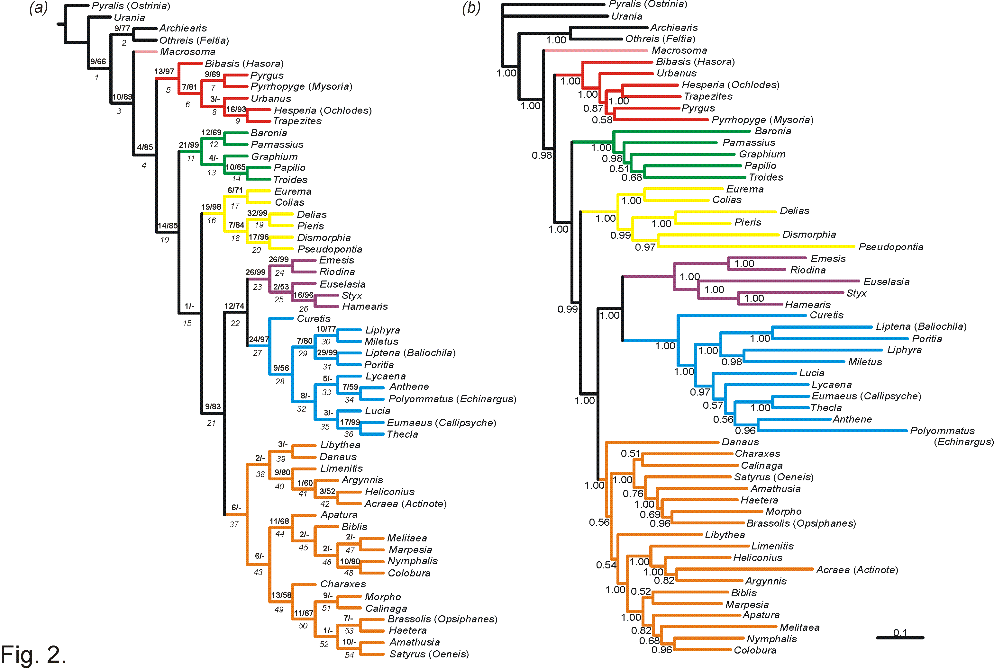
Cladograms and phylograms
Wahlberg et al. 2005 Proc R Soc

Slide 15
Chronogram (an ultrametric tree – all tips equidistant from the root)
Lehtonen et al. 2012: Bot J Linn Soc 170: 489.

Slide 16
Trees - Rooted and Unrooted
Sister groups
A
B
C
D
E
F
G
H
I
J
Sister groups
A
B
C
D
E
H
I
J
F
G
=
ROOT
ROOT
D
E
ROOT
A
F
B
H
J
G
C
I

Slide 17
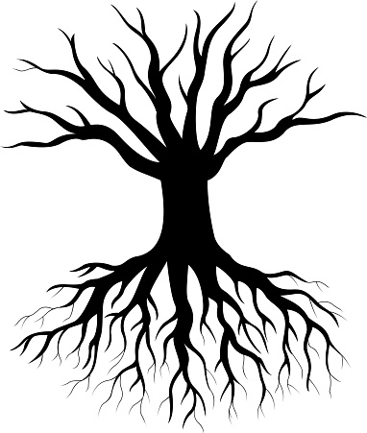
Rooting a tree
Rooting a tree using outgroups
Commonly we include several outgroups
Place the root on the branch leading to the outgroup taxon
Other ways of rooting a tree
Assume a molecular clock
Midpoint rooting (root on the longest branch)

Slide 18




Outgroup rooting of unrooted trees
Outgroup – related group that definitely diverged earlier (palaeontological evidence)
Not too distantly related (tree method becomes unreliable if it is too distant)

Slide 19
Phylogenetic systematics
Uses tree diagrams to portray relationships based upon recency of common ancestry
Monophyletic groups (clades) – contain species which are more closely related to each other than to any outside of the group, including the MRCA (most recent common ancestor)

Slide 20
Monophyletic groups
Monophyletic group = clade
- Include an ancestor and all of its descendants

Slide 21
Paraphyletic groups
- Include ancestor and some but not all of its descendants

Slide 22
Polyphyletic groups
- Include some but not all of the descendants and exclude the ancestor

Slide 23
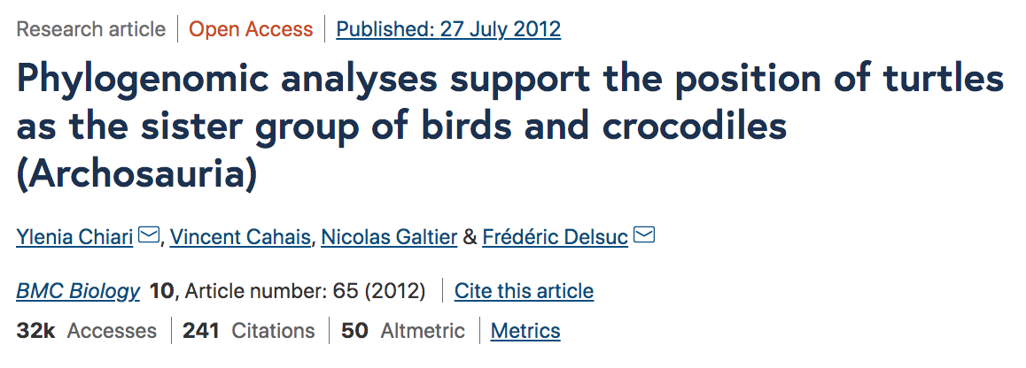
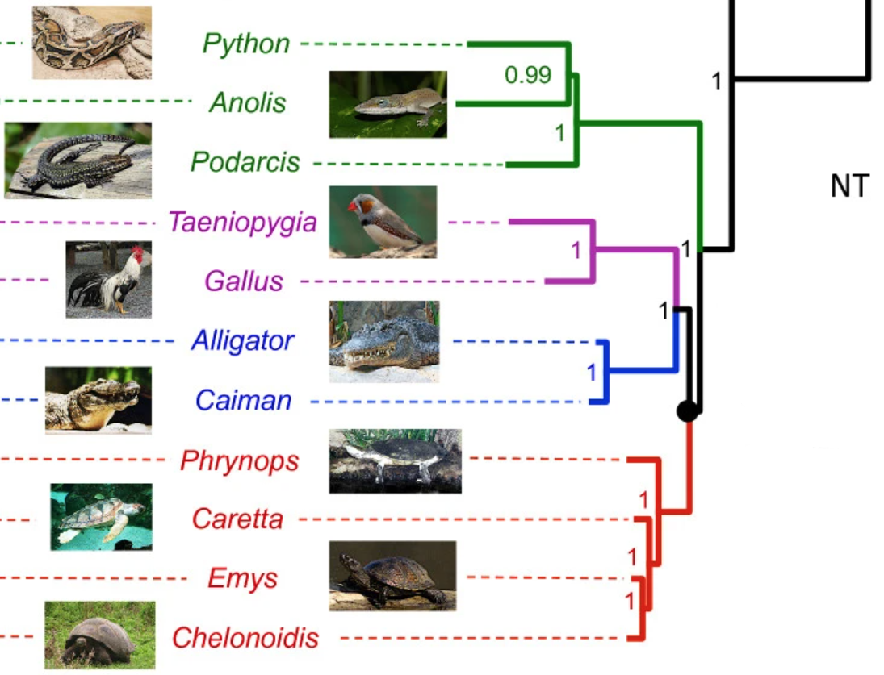
Sister groups
This question is actually not yet considered resolved!
By definition, sister groups are of equal age
Common mistake
The sister group that has fewer species is referred to as basal
Possible to have nodes that are more basal than other nodes, but not lineages compared to their sister group
Rather than saying “this group is basal”, one should say “this group is sister to all other lineages”

Slide 24
Some premises underlying phylogenetic inferences
Phylogenetic inferences are premised on
the inheritance of ancestral characters
the existence of a shared evolutionary history
Homology considered as evidence of common ancestry
A tree-like model of evolution
There are evolutionary processes that don’t fit this model, e.g. lateral transfer

Slide 25
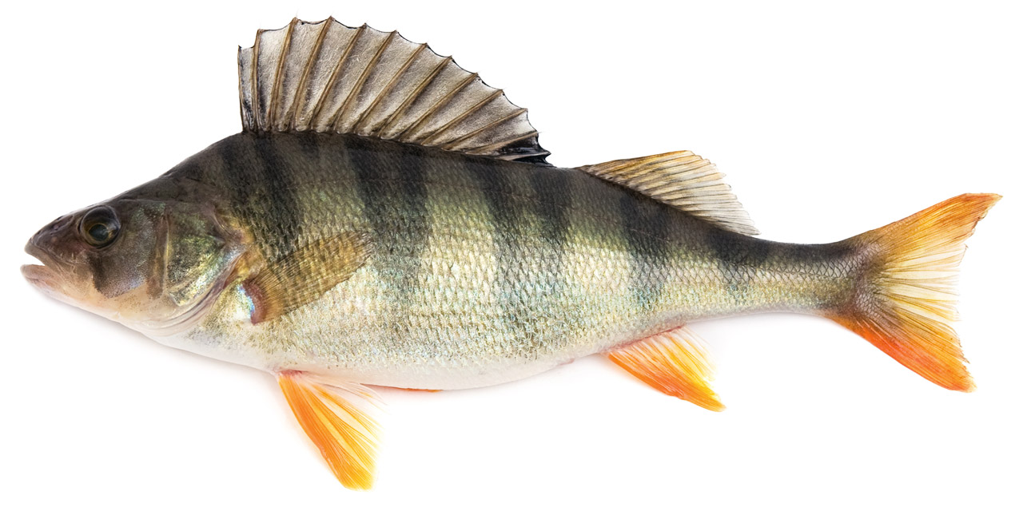
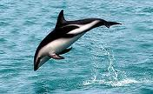
Homology
The most fundamental concept in inferring phylogeny is homology
We need to be sure the characters we are studying are homologous, i.e. ”the same” character in different organisms
Otherwise our analyses will be misled
vs.
Homology?
Homology?

Slide 26
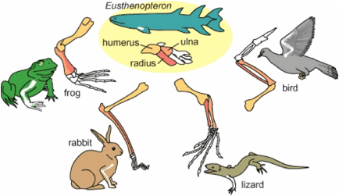
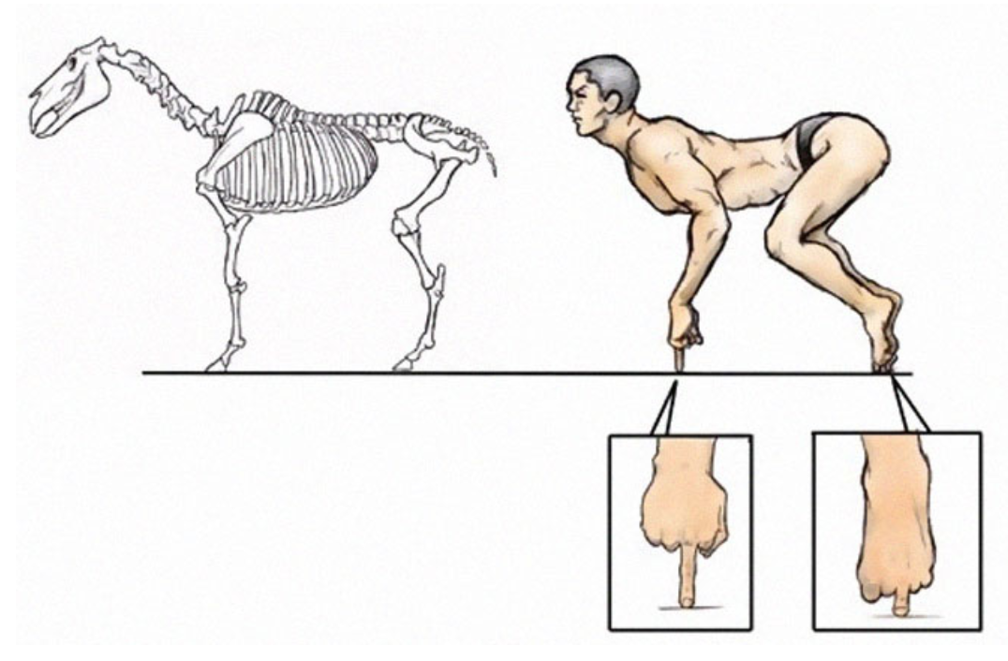
Owen’s definition of homology
Homologue: the same organ under every variety of form and function (true or essential correspondence)
Richard Owen 1843
Image source: Satoshi Kawasaki

Slide 27
Main kinds of data in phylogenetic inference
Morphological
Traditionally used in phylogenetic inference
Still necessary for fossils and when molecular data are lacking
Can also help when molecular data are ambiguous
Molecular
Most commonly used nowadays
Ease of sequencing led to a revolution in molecular phylogenetics

Slide 28
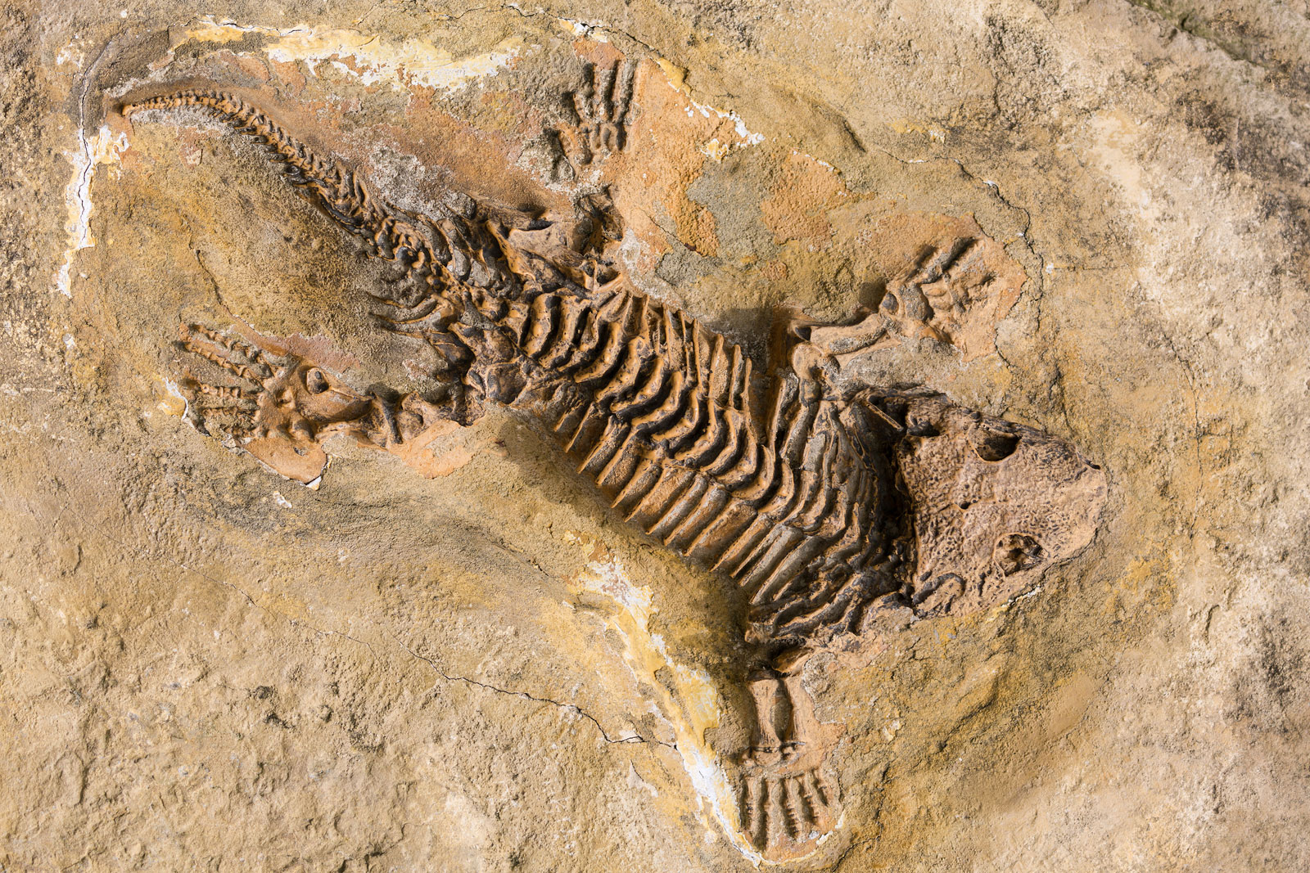

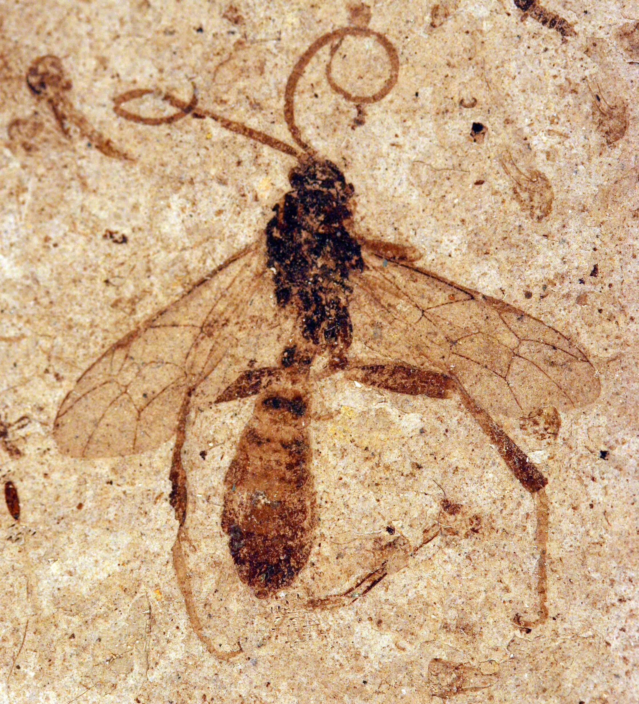
Phylogenetic analysis is an attempt to infer the past
Inferring a phylogeny is an attempt to produce a best estimate of an evolutionary history based upon incomplete information
Our direct information about the past is limited
Fossil record very incomplete
Access to contemporary species and molecules

Slide 29
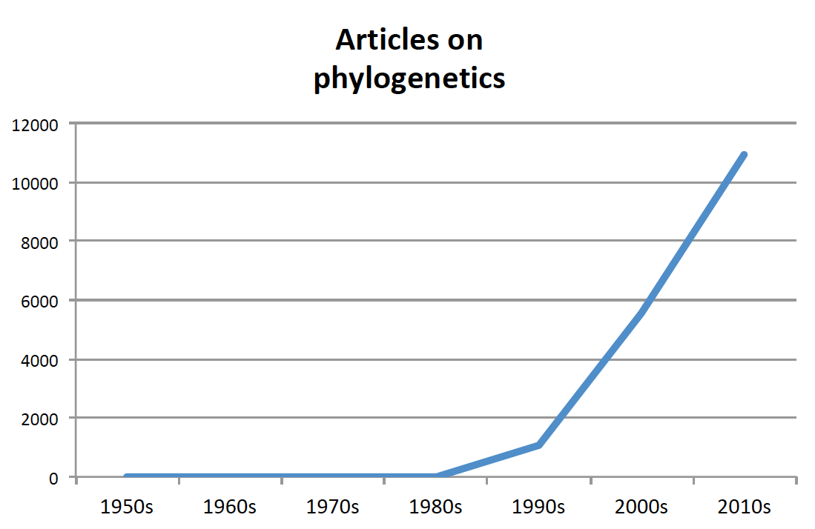
The rise of systematics
Within the last 25 years the number of phylogenetic studies has skyrocketed
Largely due to the advent of easy DNA sequencing methods
Is helping us understand biodiversity and evolutionary processes better

Slide 30
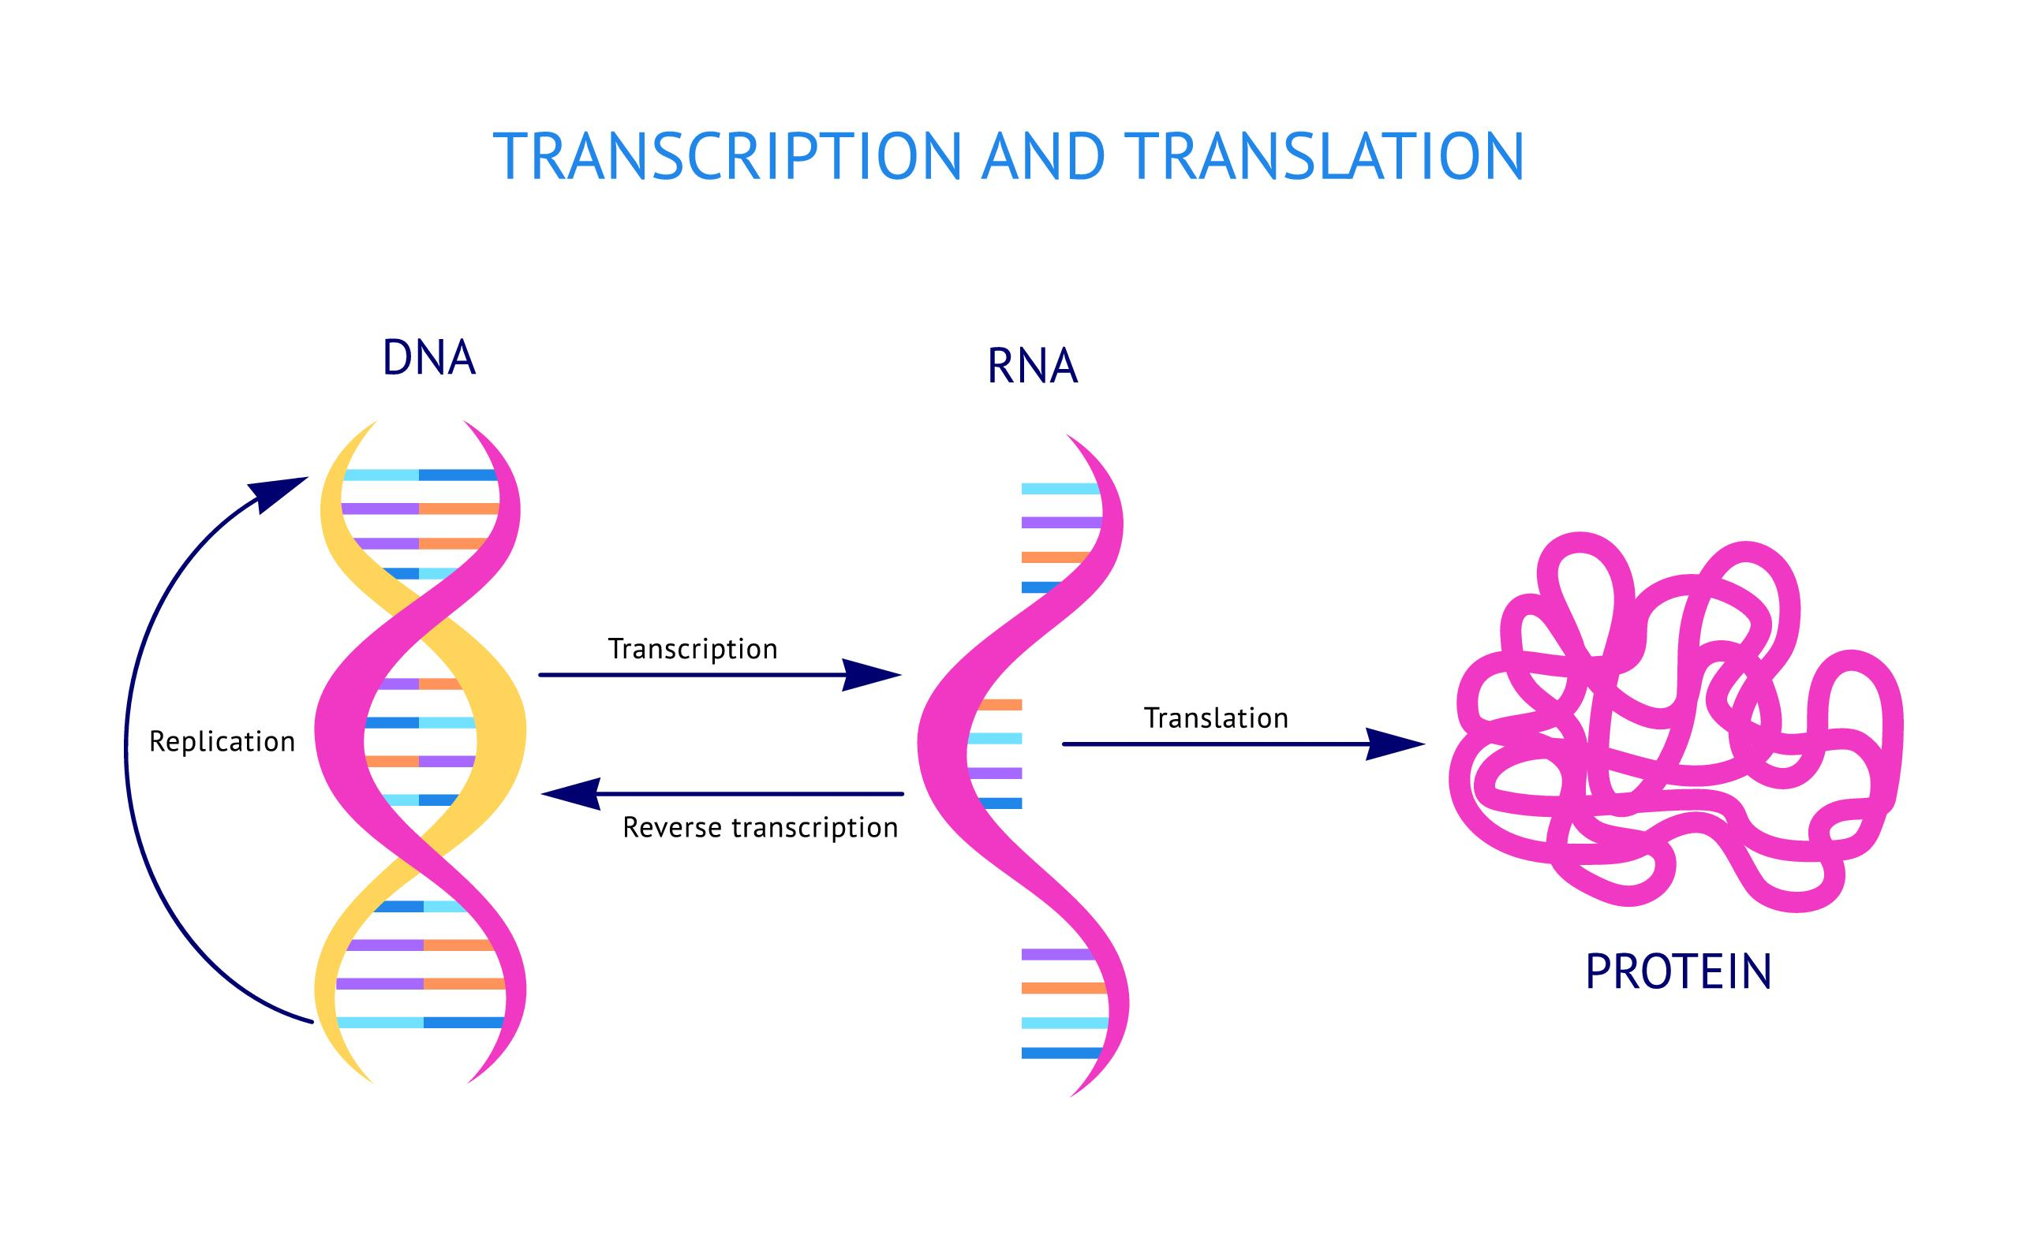
Why DNA is the Ultimate Source of Information
Higher levels lack information
For example, one can infer protein sequence from DNA sequence data, but not complete DNA sequence from protein sequence data
Lower levels provide no additional useful information
For example, sub-atomic structure does not provide information about historical relationships

Slide 31
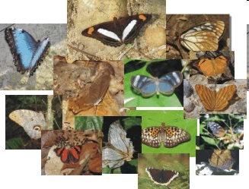
Why molecular systematics?
Ease of data generation for large numbers of taxa
Ease of generating a large number of independent data sets for given taxa
Molecular characters behind the morphological characters we see
AGCT
AGCT
AGCT
AGCT
AGCT
AGCT
AGCT
AGCT
AGCT
AGCT
AGCT
AGCT

Slide 32
Molecular systematics as a part of understanding evolution
Biochemistry — basic low-level processes (e.g., nucleotide substitution, amino acid interactions)
Molecular genetics — fundamental genetic processes (e.g., DNA replication, recombination)
Population genetics — micro-evolutionary processes
Systematics — macro-evolutionary processes

Slide 33
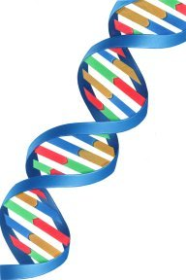
What is “Molecular” in Molecular Systematics?
Carbohydrates — No
Lipids — No
Secondary metabolites — No
Proteins (amino acids) — Yes
Nucleic Acids (DNA and RNA) — Yes
Proteins and DNA are sometimes described as “informational macromolecules”

Slide 34
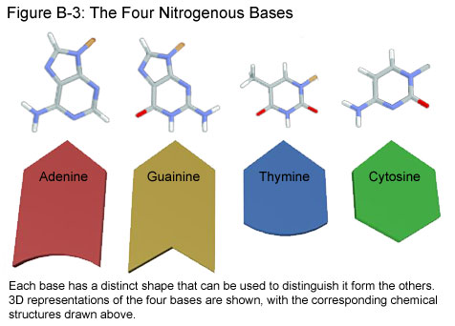
DNA as a source of information
DNA has four characters
Pyrimidines
Purines

Slide 35
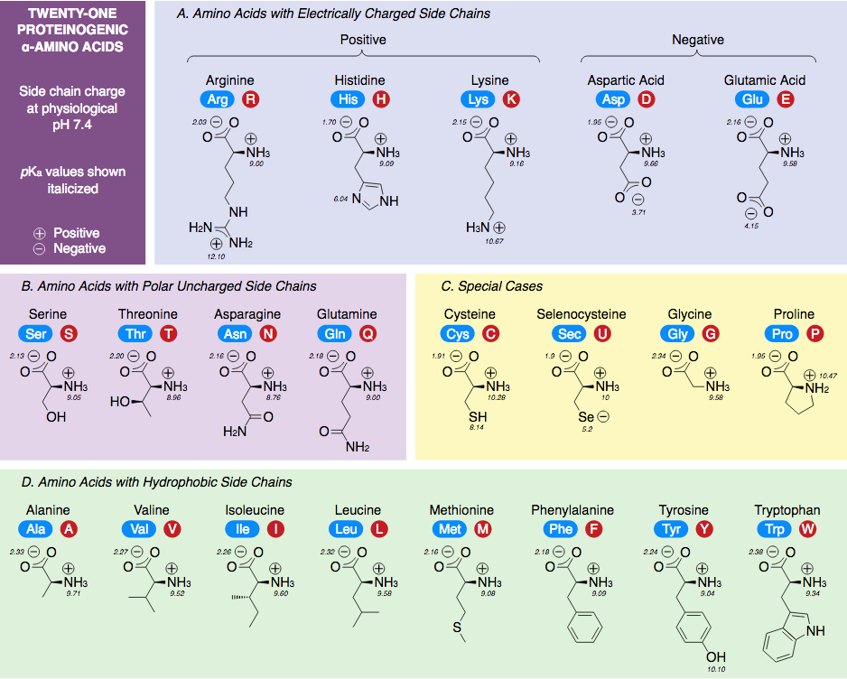
Proteins as a source of information
Protein sequences have 20 characters
Source: Wikipedia

Slide 36
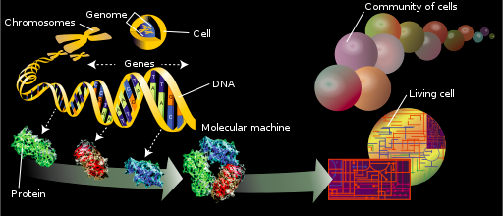
DNA found as various entities in the genome
Protein-coding genes
introns and exons
Ribosomal DNA
Repetitive elements
Regulatory regions
Junk DNA
etc

Slide 37
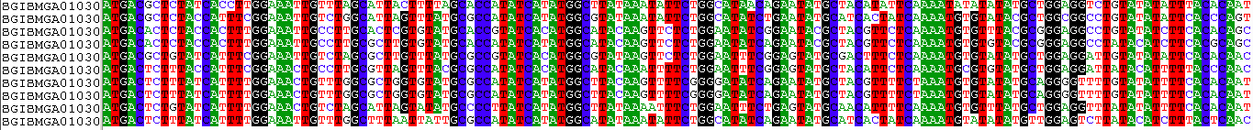
Homology in DNA sequences!
Two steps:
Are we looking at the same region of the genome in our species of interest?
Orthology vs paralogy
Are we looking at the same site within our chosen marker in our species of interest?
Alignment

Slide 38
Orthology or paralogy?
Are the genome regions sequenced from different species the same (homologous)?
Gene duplication
1) duplicate gene degenerates - pseudogene
2) duplicate gene aquires new function
A problem particularly accute currently as we analyze phylogenomic data

Slide 39
Orthology: gene trees and species trees
Gene phylogeny
Organism phylogeny
a
A
b
B
c
C
ORTHOLOGY
Orthologs: genes that arose due to speciation

Slide 40
Paralogy: can produce misleading trees
Gene phylogenies
Organism phylogeny
a1
A
b1
B
Gene copy 1
c1
C
a2
b2
Gene copy 2
c2
gene duplication
PARALOGY
Paralogs: genes that arose due to duplication events

Slide 41
Paralogy: can produce misleading trees
Gene phylogenies
Organism phylogeny
a1*
A
b1
B
Gene copy 1
c1*
C
Misleading tree
a2
a1
A
b2*
Gene copy 2
c1
C
c2
gene duplication
PARALOGY
b2
B
Paralogs: genes that arose due to duplication events

Slide 42
What sequences should we use?
Choice of sequence - appropriate for question (fast or slow evolving - close or distant relationships).
Many sequences are a mosaic of different rates
rRNA different structural regions evolve at different rates
Proteins - synonymous (silent) rate (codon position 3) is often faster than nonsynonymous (positions 1 & 2 - changes aa) rate of change
Transitions occur more readily than transversions

Slide 43
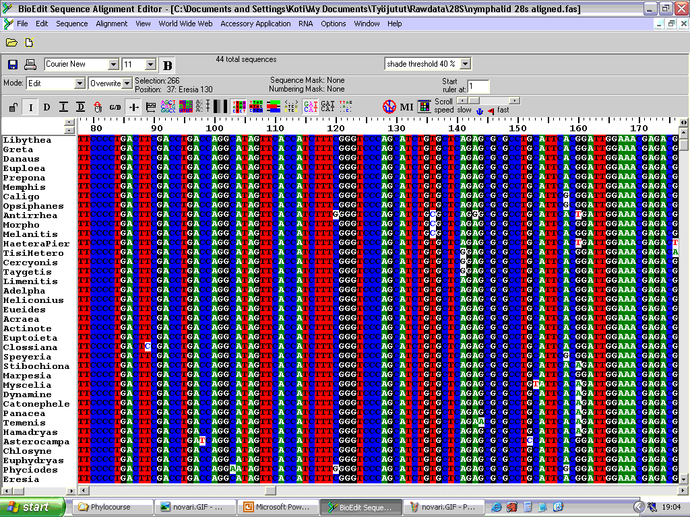

Slide 44
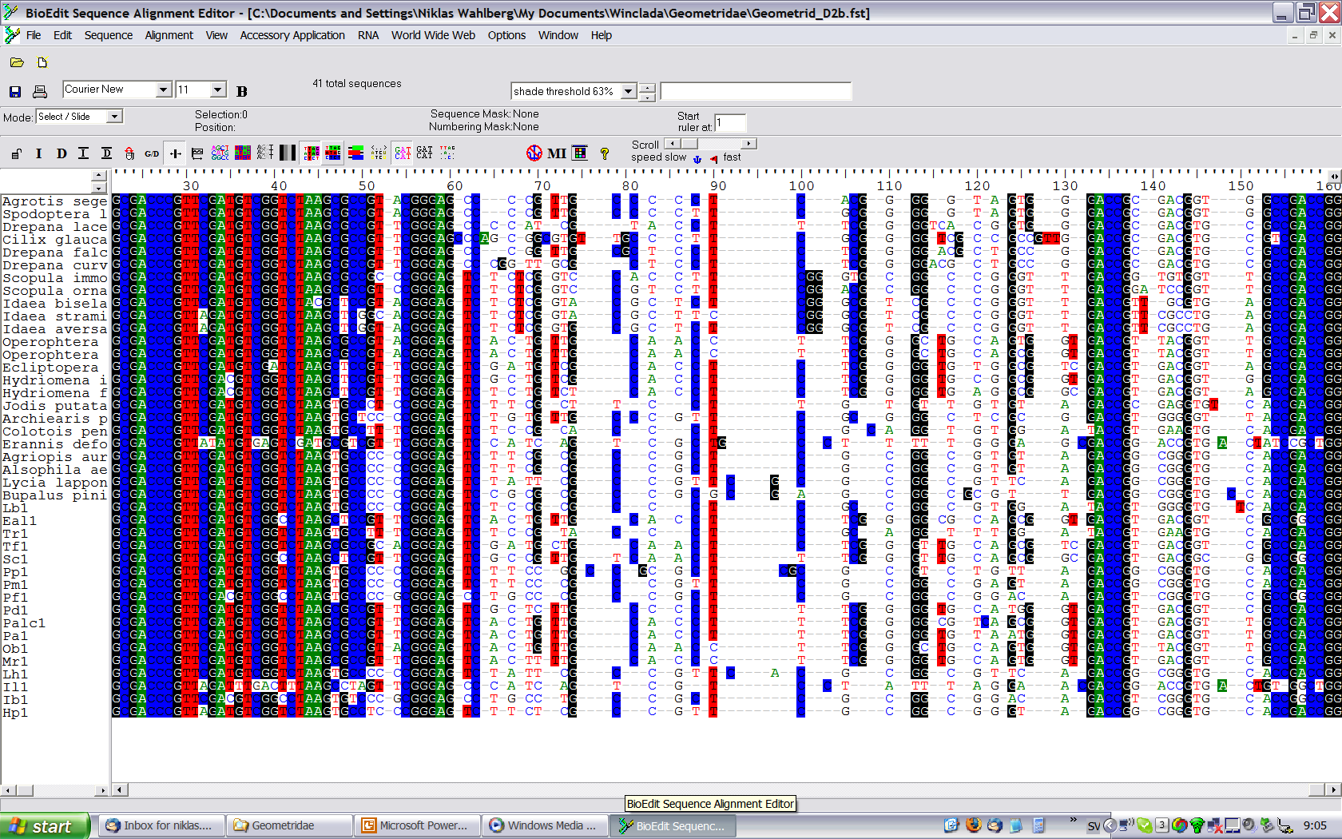

Slide 45
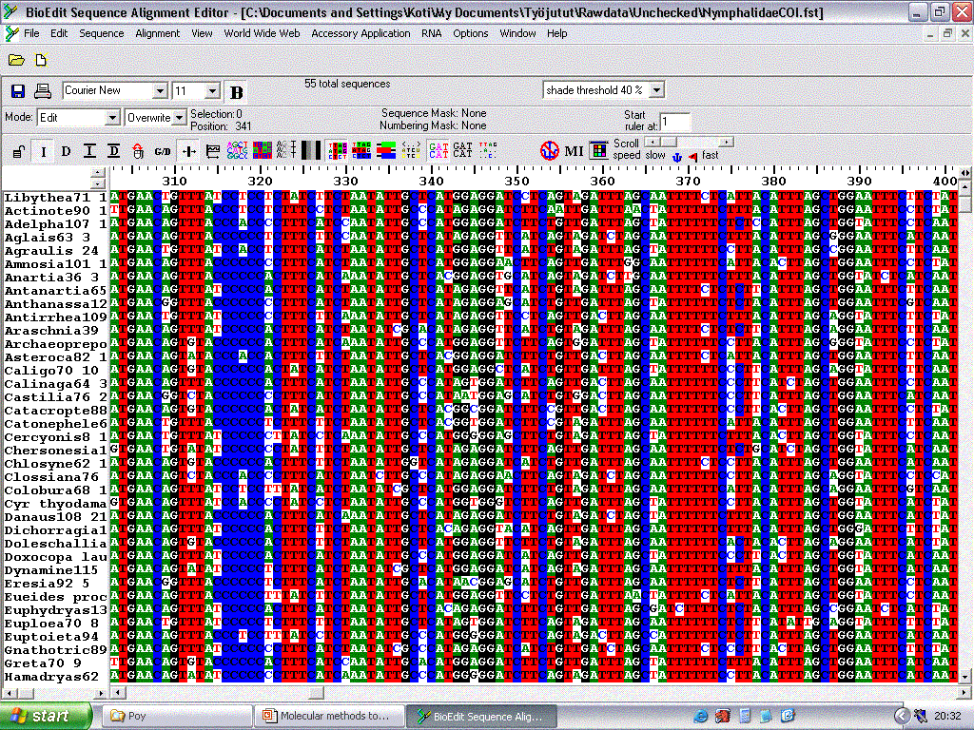

Slide 46
Data
For long, the field of systematics was restricted by the amount of data
10 years ago, datasets comprising 3-5 genes were the norm
5 years ago the genomic revolution swung into full effect
We are now faced with an abundance of potential data, but what can we do with it?

Slide 47
The Era of Phylogenomics
Genomes can now be sequenced relatively easily
Whole genomes contain a lot of information that is irrelevant for systematics, especially at deep levels
The field of systematics is still trying to figure out how best to utilize genomic level data
What parts of the genome should be used?
How can we get at those parts in the most efficient way?
Where can we access specimens for our chosen methods?

Slide 48
Phylogenomic data
RADseq
Restriction-site Associated DNA sequencing
Transcriptomes
All genes that are being expressed in a certain tissue at a certain time
Ultra-Conserved Elements
Probes to pull out UCEs and flanking regions
Anchored Hybrid Enrichment
Probes for e.g. exons of protein coding sequences
Whole Genome Sequencing

Slide 49
Some useful resources
Phylogenetics in the Genomic Era (2021)
https://hal.science/hal-02535070v3
Phylogenomics: An Introduction (2017)
https://link.springer.com/book/10.1007/978-3-319-54064-1

Slide 50
Evolutionary History and Its Importance in Biology

Slide 51
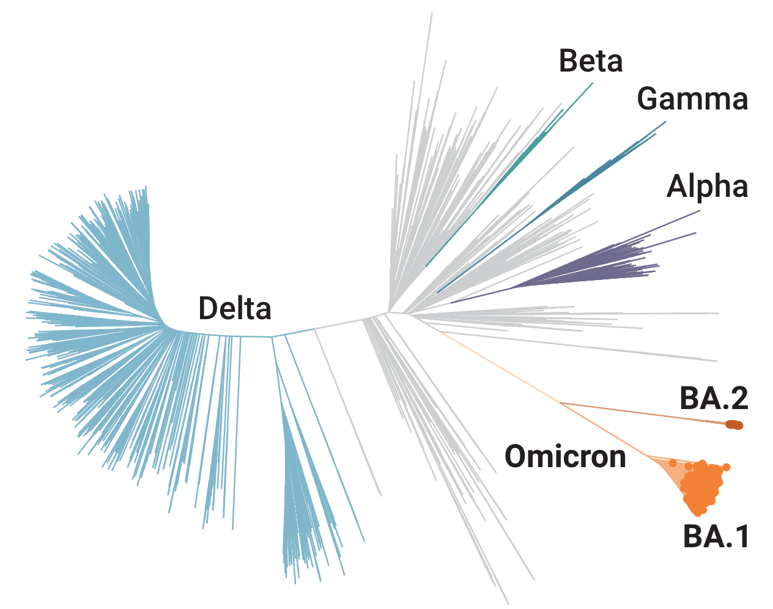
Why do we need phylogenies?
What is shown here?
https://www.science.org/content/article/sudden-rise-more-transmissible-form-omicron-catches-scientists-surprise?utm_campaign=SciMag&utm_source=Social&utm_medium=Twitter

Slide 52
Why do we need phylogenies?
What is shown here?
Phylogeny of covid-19 strains
https://www.science.org/content/article/sudden-rise-more-transmissible-form-omicron-catches-scientists-surprise?utm_campaign=SciMag&utm_source=Social&utm_medium=Twitter

Slide 53

Go to the website: menti.com Code: 1771 4629
Quiz on the importance of evolutionary history
6 questions
Back to lecture to have a look at the answers together

Slide 54
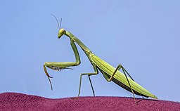
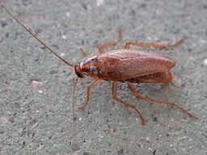
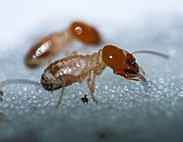
1. Which statement is correct?
Praying mantids, cockroaches, and termites are distantly related insects.
Termites are highly modified cockroaches.
Termites are more closely related to ants than to cockroaches.

Slide 55
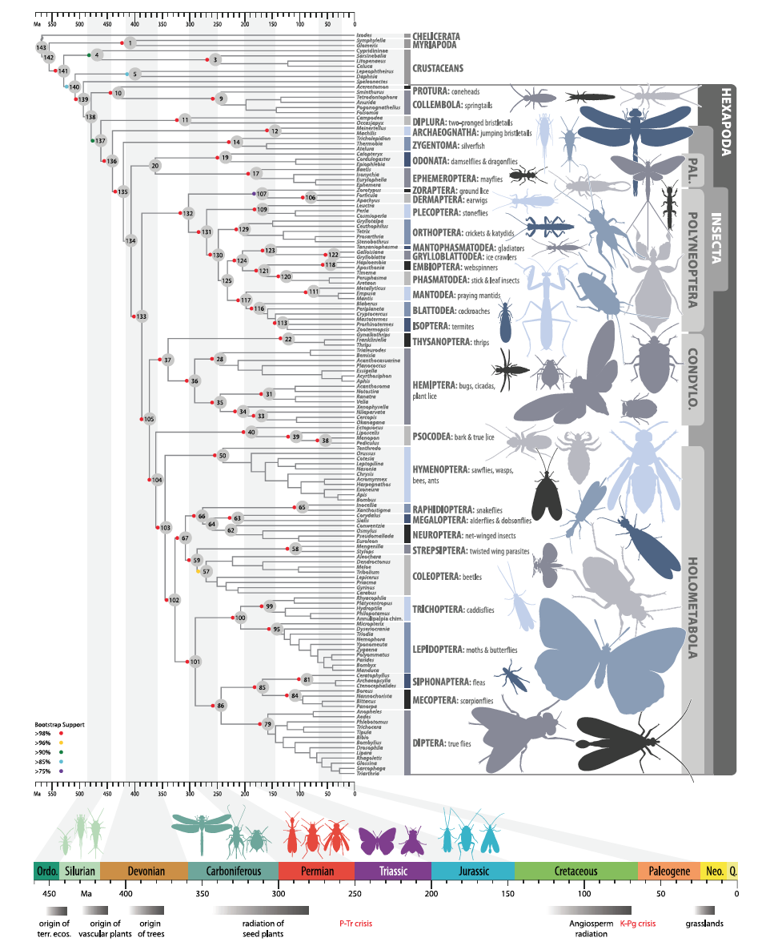

Systematics: praying mantids are the sister group of cockroaches and termites are derived cockroaches
Image source: Wikipedia

Slide 56
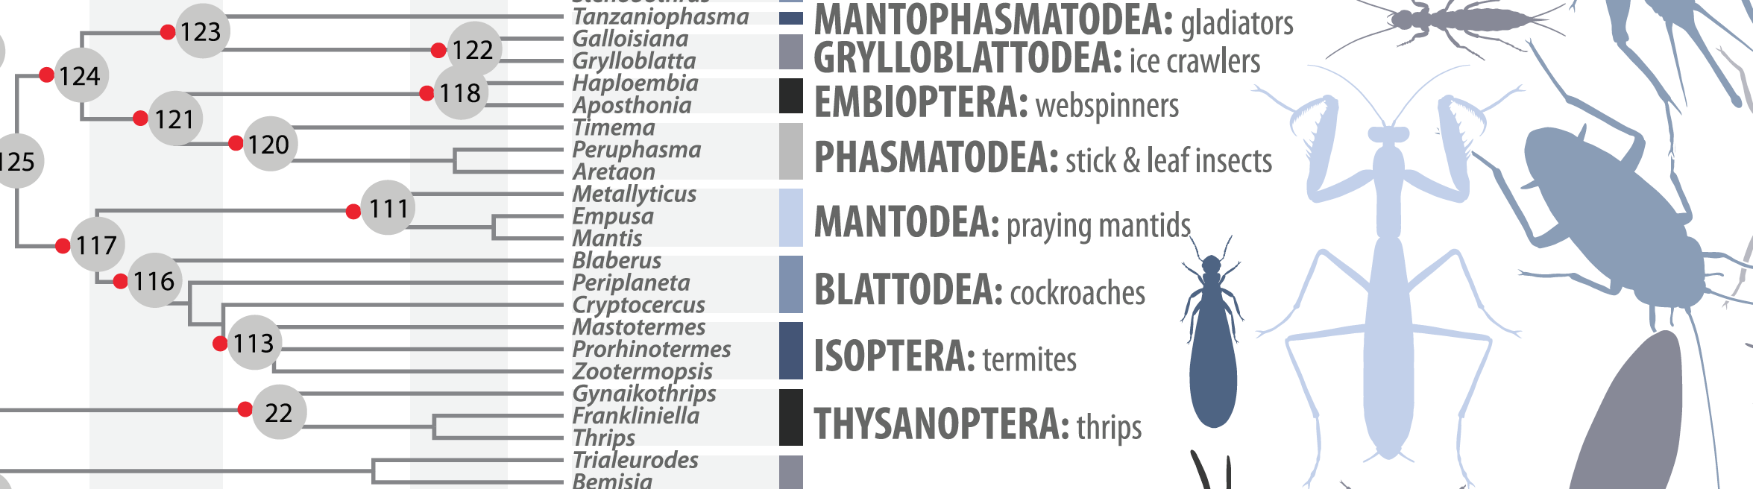
Systematics: praying mantids are the sister group of cockroaches and termites are derived cockroaches
Cockroaches are paraphyletic with respect to termites
Termites have to be included within cockroaches to have a natural classification because termites are nested within cockroaches

Slide 57
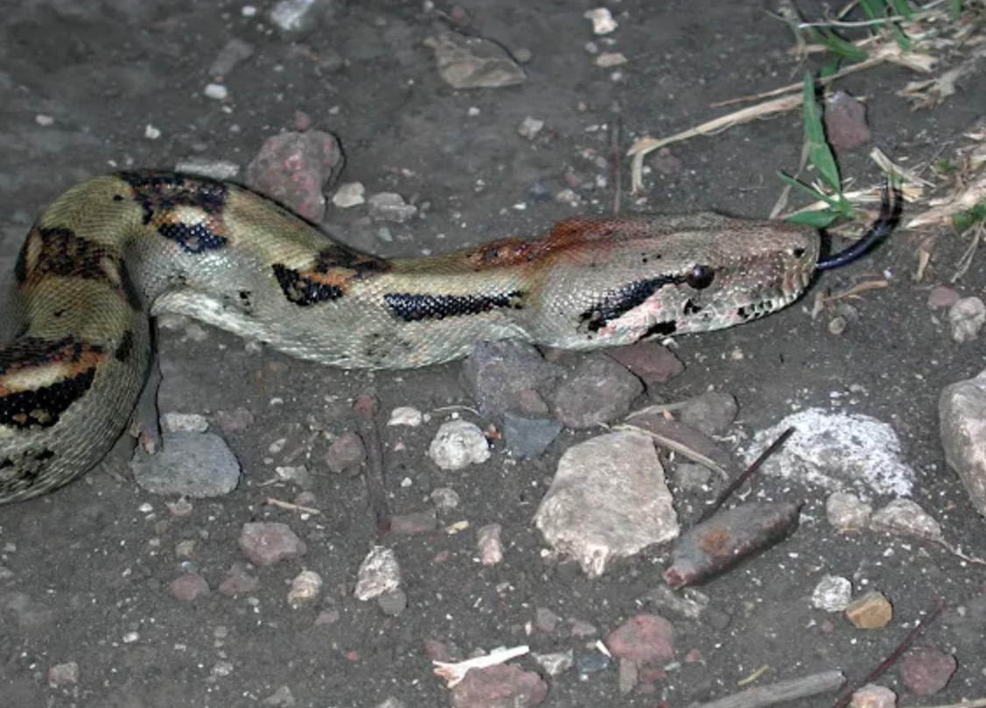
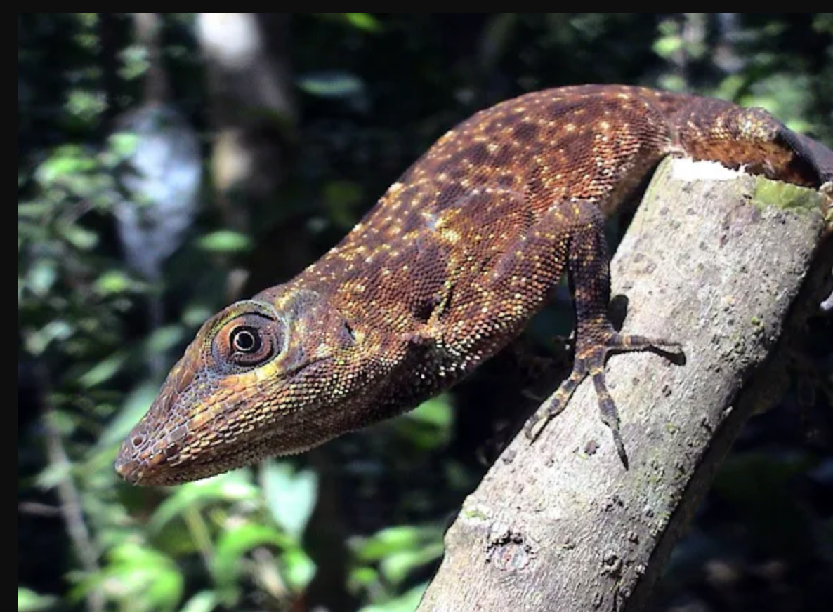
2. Which statement is true?
Snakes are the sister group of lizards.
Some lizards are more closely related to the snakes than to other lizards.
Snakes are reptiles that are not closely related to lizards.

Slide 58
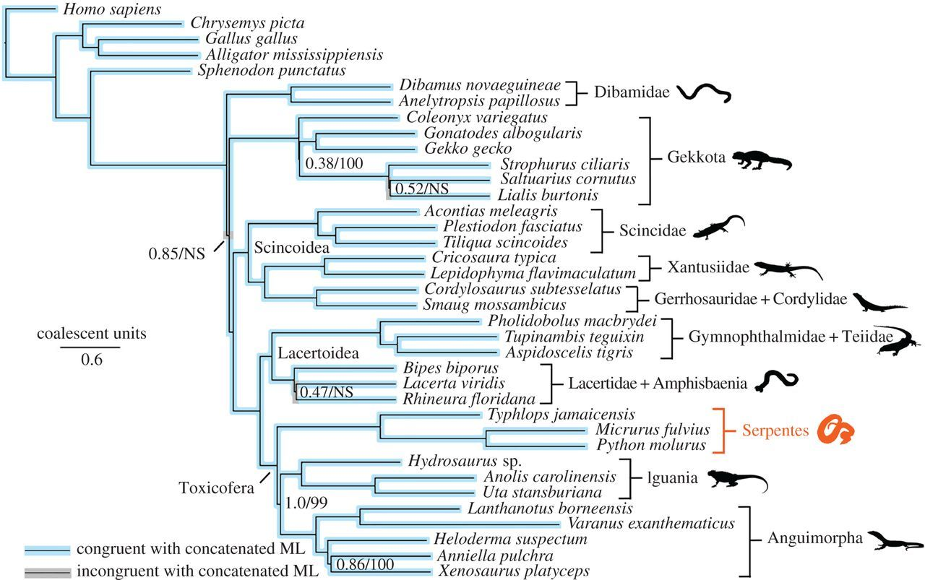
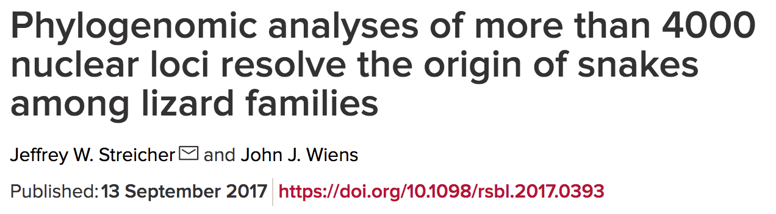
Systematics: Snakes are one of several lizard lineages that have lost limbs
OUTGROUPS

Slide 59
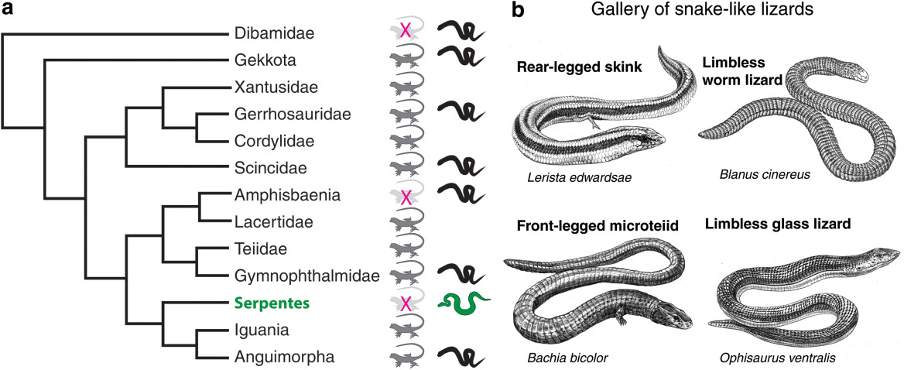
Systematics: Snakes are one of several lizard lineages that have lost limbs
Leal & Cohn (2018) Developmental, genetic, and genomic insights into the evolutionary loss of limbs in snakes. Genesis, Volume: 56, Issue: 1, First published: 02 November 2017, DOI: (10.1002/dvg.23077)

Slide 60
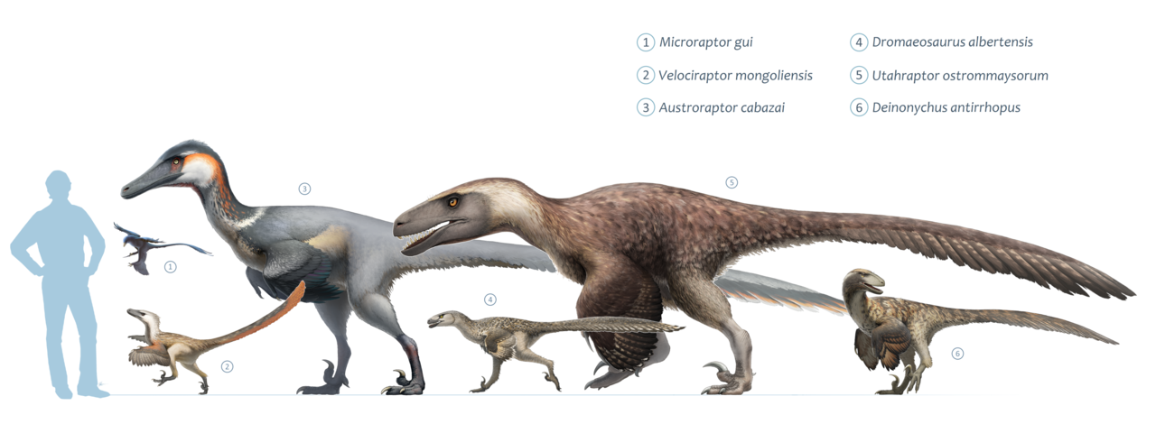
3. Dinosaurs…
… belong to reptiles but are not closely related to birds.
… are the sister group of birds.
… are paraphyletic with respect to birds.
Image source: Wikipedia

Slide 61
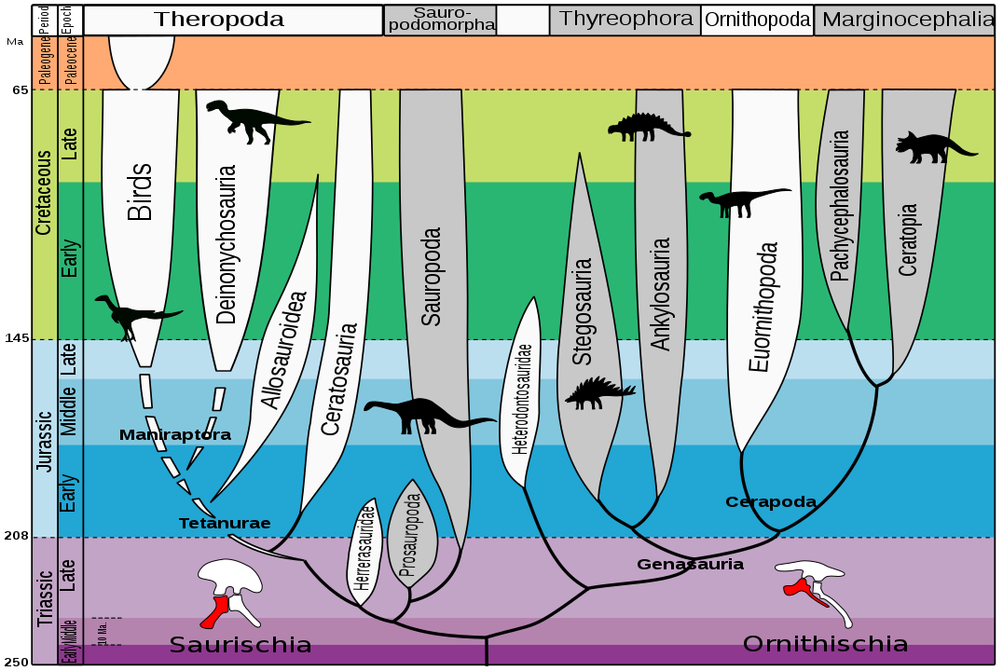
Are dinosaurs extinct?
Avian dinosaurs
Non-avian dinosaurs
Dinosaurs are paraphyletic with respect to birds
Pseudoextinction

Slide 62
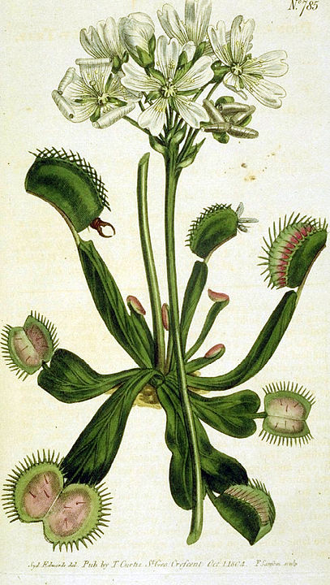
4. Carnivorous plants …
… evolved only once.
… evolved independently at least 5 times.
… are a myth. There are no plants that eat animals.
Image source: Wikipedia

Slide 63
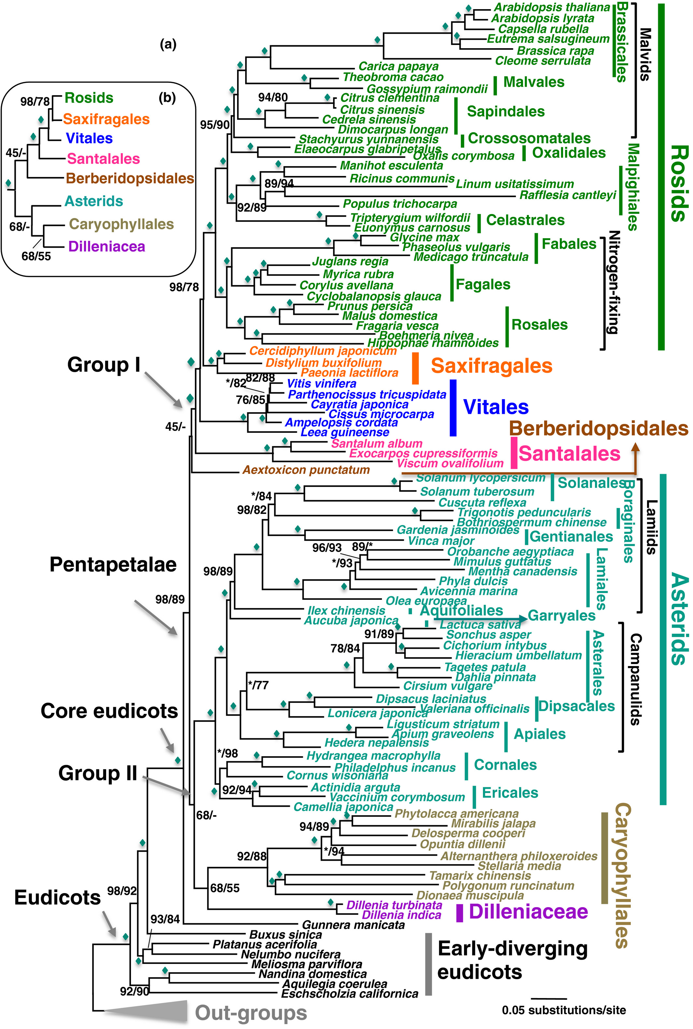
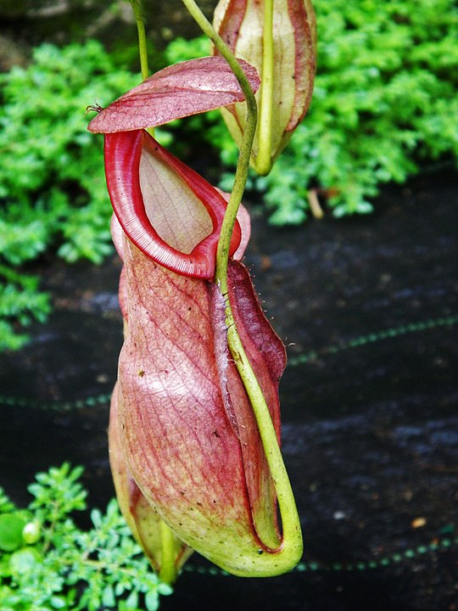
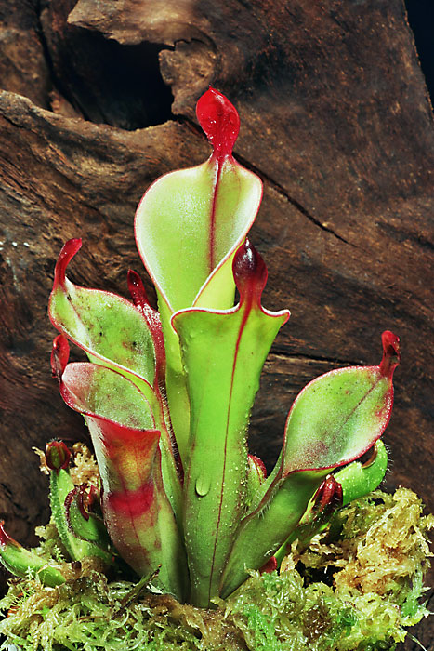
Convergent evolution: pitcher plants
Sarraceniaceae
Nepenthaceae
Nepenthaceae
Order Caryophyllales
Sarraceniaceae
Order Ericales
Zeng et al. (2017) https://doi.org/10.1111/nph.14503

Slide 64
Classification of carnivorous plants
Order: Caryophyllales
Families: Nepenthaceae, Drosophyllaceae, Dioncophyllaceae, Droseraceae
Order: Oxalidales
Family: Cephalotaceae
Order: Ericales
Family: Sarraceniaceae
Order: Lamiales
Families: Lentibulariaceae, Byblidaceae
Order: Poales
Family: Bromeliaceae

Slide 65

5. Swim bladder in fishes …
… evolved from the precursor of lungs.
Swim bladder and lungs are two organs that are not homologous.
Lungs evolved from the swim bladder.
Image source: Shutterstock.com

Slide 66

Understanding directionality of character evolution
Swim bladder in fishes and lungs in tetrapods are homologous
Darwin erroneously believed that lungs evolved from the swim bladder
He was right thinking that an organ with one function can evolve into an organ with a different function BUT the swim bladder actually evolved from the lung precursor!
C. Darwin: On the Origin of Species (1961 ed.), p. 210

Slide 67

Lungs and swim bladders are homologous
Cupello et al. 2022 https://doi.org/10.7554/eLife.77156

Slide 68
6. Best hypothesis for the relationships among the three domains of life is:
A B C

Slide 69

Origin of Eukarya
Eukaryotes
Organisms whose cells have a nucleus enclosed within a nuclear envelope
Plants, animals, fungi + a lot of single-cell lineages
Which lineage is the sister lineage to Eukarya?
Why is this interesting?
Where does the complex cell of eukaryotes originate from?
The Woese three domain tree of life
The Eocyte hypothesis
Fig. 4 from MacLeod et al. 2019 (doi: 10.3934/microbiol.2019.1.48)

Slide 70

Origin of Eukarya
Which lineage is the sister lineage to Eukarya?
Discovery of Asgard Archaea is complicating the picture
Figure 5. (A) The tree of life resulting from a range of phylogenetic analyses of conserved markers, ribosomal RNA genes and ribosomal proteins, placing Asgard archaea as the closest archaeal relatives of eukaryotes. (B) The tree produced from phylogenetic analyses of Asgard RNA polymerase genes supports the three-domain topology of the tree of life, with Asgard archaea as a sister group to Euryarchaeota.
Fig. 5. MacLeod et al. 2019 (doi: 10.3934/microbiol.2019.1.48)

Slide 71

Molecular evolution: arms race between caterpillars and their host plants
Plants have secondary metabolites
One of the functions: protection from herbivory
Insects can evolve the ability to metabolize plant secondary metabolites
Then plants can evolve new chemicals, and we have an arms race
Example: Edger et al. 2015 PNAS study

Slide 72

Edger et al. 2015. The butterfly plant arms-race escalated by gene and genome duplications
Butterflies: family Pieridae
Plants: order Brassicales
A number of gradual changes
BUT also gene and genome duplications
The story: “Nearly 90 million years ago, the ancestors of Brassica (mustards, cabbage) and related plants developed a chemical defense called glucosinolates.”
Glucosinolates – toxic to most insects, for humans source of the sharp taste in wasabi, horseradish, and mustard
Cabbage Butterfly Pieris brassicae (Linnaeus, 1758)
By Didier Descouens - Own work, CC BY-SA 4.0

Slide 73

WGD
= whole genome duplications
Edger et al. 2015 Fig. 1

Slide 74

Timing of divergence for plants and butterflies carried out on independent data
Butterflies colonized the host plants after they had evolved their chemical defences
Edger et al. 2015 Fig. 1

Slide 75

It appears that colonizing chemically protected host plants allowed the butterflies to speciate faster
Edger et al. 2015 Fig. 1

Slide 76

Figure 2. (B) An illustration of the evolution of core glucosinolate pathways across Brassicales; with substrates tryptophan (Trp), phenylalanine (Phe), and methionine (Met) shown at the top, enzymes depicted as white ovals, and each pathway as black vertical lines.
Figure 2. (D) Evolution of the NSP gene family is shown across select Pierinae genera, indicating the birth and death dynamics of four paralogous clades.
*Nitrile Specificer Protein (NSP): primary detoxification mechanism used by the butterflies to break down this chemical defense system

Slide 77
Criminal investigations: evolutionary history of a deliberate HIV infection
Source: Herron & Freeman “Evolutionary Analysis” 5th edition
Players in this true story:
Janet Trahan, nurse – the accuser
Richard Schmidt, physician – the accused
David Hillis, evolutionary biologist – providing crucial evidence
Legal case:
Trahan became sick with HIV and accused Schmidt of deliberately injecting her with blood from a HIV-positive patient as revenge for breaking off their affair
Analysis:
Evolutionary history of viral samples from various people to establish from where Trahan contracted her virus

Slide 78


Source: Herron & Freeman “Evolutionary Analysis” 5th edition

Slide 79
Importance of Understanding Evolutionary History: examples we talked about (there could be many, many more)
Viral evolution and its impact on human health
Systematics – understanding the relationships among different groups of organisms and how they acquired their current form and function
E.g. snakes and lizards, birds and dinosaurs, the main domains of life
Molecular evolution
Genome and gene duplications as weapons in an arms race between plants and caterpillars
Even criminal investigations!

